Slide 1




Slide 2

TEST TIME ON KARATSUBA ALGORITHM
URL:https://forms.gle/xEEUwT9RBBfCFkZA8
QR CODE:

Slide 3

LONGEST SEQUENCE OF 1S AFTER FLIP

Slide 4
Introduction:
The "Longest Sequence of 1s after flip" problem involves finding the maximum length of a sequence of consecutive 1s that can be obtained by flipping a limited number of 0s to 1s.
This problem is commonly encountered in computer science, specifically in the context of binary strings or arrays.
The goal is to identify the longest sequence of 1s that can be achieved by flipping a predetermined number of 0s to 1s.
The flip operation involves changing a 0 to a 1. By strategically selecting which 0s to flip, we aim to maximize the length of the resulting sequence of 1s.

Slide 5
Introduction:
The aim is to identify the configuration that yields the maximum length of consecutive ones within the allowed number of flips.
It's important to note that the number of allowed flips can greatly impact the result. A higher number of flips generally allows for a longer sequence of ones, while a limited number of flips may result in a shorter sequence.

Slide 6
Example: 11011101111
Step 1:
11011101111
11111101111
Flipping the First 0 results in 11111101111
length of the sequence of consecutive 1s=6

Slide 7
Step 2:
11011101111
11011111111
Flipping the second 0 results in 11011111111
length of the sequence of consecutive 1s=8
where the longest sequence of 1s is 8 long.

Slide 8
Example: 1110001111 k=2
Step 1:
1110001111
1111101111
After Flipping 0 results in 1111101111
length of the sequence of consecutive 1s=5

Slide 9
Step 2:
1110001111
1110111111
After Flipping 0 results in 1110111111
length of the sequence of consecutive 1s=6 where the longest sequence of 1s is 6 long.

Slide 10
import java.util.Scanner; class LongestSubarrayWithOnesAfterReplacement { private static int findMaxConsecutiveOnes(int[] a, int k) { int maxOnes = Integer.MIN_VALUE; int numReplacements = 0; int windowStart = 0; for(int windowEnd = 0; windowEnd < a.length; windowEnd++) { if(a[windowEnd] == 0) { numReplacements++; } while(numReplacements > k) { if(a[windowStart] == 0) { numReplacements--; } | windowStart++; } maxOnes = Math.max(maxOnes, windowEnd-windowStart+1); } return maxOnes; } public static void main(String[] args) { int[] a = new int[]{1, 1, 1, 1, 0, 0, 0, 1, 1, 1, 1, 1, 0}; int k = 1; int result = findMaxConsecutiveOnes(a, k); System.out.printf("Length of longest contiguous subarray containing only 1s after replacement = %d%n", result); } }
Notes:
Length of longest contiguous subarray containing only 1s after replacement = 6

Slide 11
Time Complexity and space complexity
Time Complexity: O(n), where n is the number of bits in the binary representation of the given number.
Space Complexity: O(1)
Notes:
Length of longest contiguous subarray containing only 1s after replacement = 6

Slide 12

Describe the problem of finding the longest sequence of 1s after flipping a maximum of 'k' 0s.
This problem involves finding the longest contiguous subarray consisting of 1s, where we are allowed to flip at most 'k' 0s to 1s. The goal is to determine the maximum length of such a subarray.

Slide 13
What is the time complexity of your solution?
The time complexity is O(n), where n is the length of the binary sequence. We iterate through the sequence only once, and each iteration takes constant time operations.

Slide 14
How would you modify the solution if you were allowed to flip any number of 0s?
If we can flip any number of 0s, we can simply count the number of 0s encountered and keep track of the maximum length of the sequence of 1s seen so far. Whenever we encounter a 0, we update the maximum length if necessary and reset the count of 0s.

Slide 15
What is the space complexity of the given algorithm to find the longest sequence of 1s after flip?
The space complexity of the given algorithm is O(1), constant space. It does not use any extra space that grows with the input size. The algorithm only requires a few variables to keep track of the current length, maximum length, and the count of 0s encountered, which remain constant regardless of the input size.

Slide 16

https://learn.codemithra.com

Slide 17
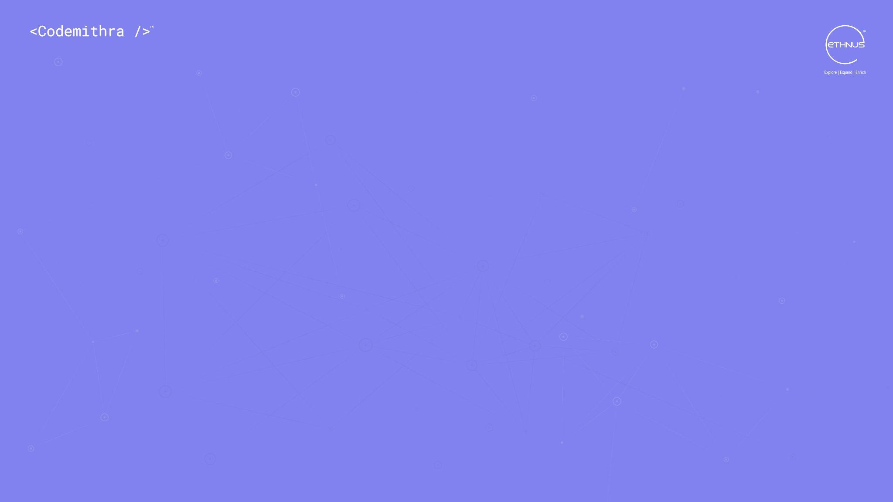



THANK YOU
+91 78150 95095
codemithra@ethnus.com
www.codemithra.com

